Slide 1






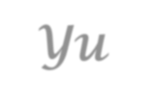


Introduction to
Algorithm Design and Analysis
[12] Directed Acyclic Graph
Yu Huang
http://cs.nju.edu.cn/yuhuang Institute of Computer Software Nanjing University

Slide 2

In the last class…
Depth-first and breadth-first search
Finding connected components
General depth-first search skeleton
Depth-first search trace

Slide 3


Applications of Graph Decomposition
Directed Acyclic Graph
Topological order
Critical path analysis
Strongly Connected Component (SCC)
Strong connected component and condensation
Leader of strong connected component
The algorithm

Slide 4





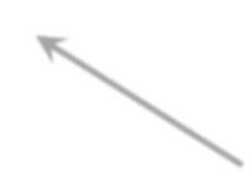



For Your Reference
tree edge back edge cross edge
starting vertex
v₁
A DFS tree partially formed at the moment the search
tree edge not accessed yet
descendant edge not accessed yet
checking v₃ from v₆
v₄
v₂
v
5
v₃
v₆
white path
Now, here
v₇
v₈
* Note: v is reachable from v , and is
4 6
white, but it is not a descendant of v₆

Slide 5


Directed Acyclic Graph (DAG)
3
3
2
4
2
4
1
5
1
5
6
9
6
9
7 8
Not a DAG
7 8
A Directed Acyclic Graph

Slide 6


Topological Order for G=(V,E)
Topological number
8
An assignment of distinct integer 1,2,…, n to the vertices of V
For every vw∈E, the topological number of v is less than that of w.
Reverse topological order
o Defined similarly (“greater than” )
7
3
4
9
2
3
₂ 1
5
₄ 6
9
1
7
5
8
6

Slide 7








Existence of Topological Order – a Negative Result
If a directed graph G has a cycle, then G has no topological order
3
Proof
o [By contradiction]
2
4
y
yx-path
xy-path
1
5
For any given topological order, all the vertices on both paths must be in increasing order. Contradiction results for any assignments for x and y.
6
x
9
7
8

Slide 8


Reverse Topological Ordering
Specialized parameters
Array topo, keeps the topological number assigned to each vertex.
Counter topoNum to provide the integer to be used for topological number assignments
Output
Array topo as filled.

Slide 9





Reverse Topological Ordering
void dfsTopoSweep(IntList[ ] adjVertices,int n, int[ ]
topo)
int topoNum=0
<Allocate color array and initialize to white>
For each vertex v of G, in some order
if (color[v]==white)
dfsTopo(adjVertices, color, v, topo, topoNum);
// Continue loop
return;
For non-reverse topological ordering, initialized as n+1

Slide 10



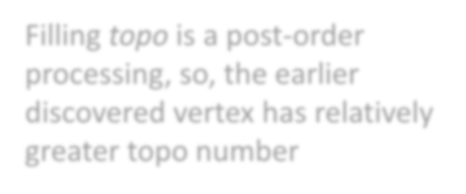


Reverse Topological Ordering
void dfsTopo(IntList[] adjVertices, int[] color, int v, int[ ]
topo, int topoNum)
int w; IntList remAdj; color[v]=gray; remAdj=adjVertices[v];
while (remAdj≠nil) w=first(remAdj);
if (color[w]==white)
Obviously, in Θ(m+n)
dfsTopo(adjVertices, color, w, topo, topoNum);
remAdj=rest(remAdj); topoNum++; topo[v]=topoNum color[v]=black;
return;
Filling topo is a post-order processing, so, the earlier discovered vertex has relatively greater topo number

Slide 11


Correctness of the Algorithm
If G is a DAG with n vertices, the procedure dfsTopoSweep computes a reverse topological order for G in the array topo.
Proof
The procedure dfsTopo is called exactly once for a vertex, so, the numbers in topo must be distinct in the range 1,2,…n.
For any edge vw, vw can’t be a back edge(otherwise, a cycle is formed). For any other edge types, we have finishTime(v)>finishTime(w), so, topo(w) is assigned earlier than topo(v). Note that topoNum is incremented monotonically, so, topo(v)>topo(w).

Slide 12


Existence of Topological Order
In fact, the proof of correctness of topological ordering has proved that: DAG always has a topological order.
So, G has a topological ordering, iff. G is a directed acyclic graph.

Slide 13

Task Scheduling
Problem:
Scheduling a project consisting of a set of interdependent tasks to be done by one person.
Solution:
Establishing a dependency graph, the vertices are tasks, and edge vw is included iff. the execution of v depends on the completion of w,
Making task scheduling according to the topological order of the graph(if existing).

Slide 14









Task Scheduling: an Example
Tasks(No.) Depends on
-------------------------------
choose clothes(1) 9
dress(2) 1,8
eat breakfast(3) 5,6,7
leave(4) 2,3
make coffee(5) 9
make toast(6) 9
pour juice(7) 9
shower(8) 9
wake up(9) -
The DAG
9/16/8
5/8/4
3
17/18/9
4
2
1/4/2
10/11/5
1
5
6
9
2/3/1
12/13/6
8
6/7/3
7
A reverse topological order
9, 1, 8, 2, 5, 6, 7, 3, 4
14/15/7
Start time/finish time/topo #

Slide 15






Project Optimization Problem
Assuming that parallel executions of tasks (v_{i}) are possible except for prohibited by interdependency.
Observation
In a critical path, v_{i-1}, is a critical dependency of v_{i}, i.e. any delay in v_{i-1}will result in delay in v_{i}.
The time for entire project depends on the time for the critical path.
Reducing the time of a off-critical-path task is of no help for reducing the total time for the project.
The problems
This is a precondition.
Find the critical path in a DAG
(Try to reduce the time for the critical path)

Slide 16


Critical Path in a Task Graph
Earliest start time(est) for a task v
If v has no dependencies, the est is 0
If v has dependencies, the est is the maximum of the earliest finish time of its dependencies.
Earliest finish time(eft) for a task v
For any task: eft = est + duration
Critical path in a project is a sequence of tasks: v₀, v₁, …, v_{k}, satisfying:
o v₀ has no dependencies;
For any v_{i}(i=1,2,…,k), v_{i-1} is a dependency of v_{i}, such that est of v_{i} equals eft of v_{i-1};
o eft of v_{k}, is maximum for all tasks in the project.

Slide 17




DAG with Weights
eat: 6
3
leave: 1
4
Critical Path Critical Subpath
dress: 6.5
2
choose: 3
1
1
coffee: 4.5 5
3
0
toast: 2
8
2
6
9
wake:0
0
8.5
6.5
juice: 0.5 7
8
shower: 8.5
5
0
0
0
4.5
9
1
done
6
4
2
6.0
3
7
0.5

Slide 18




Critical Path Finding - DFS
Specialized parameters
Array duration, keeps the execution time of each vertex.
Array critDep, keeps the critical dependency of each vertex.
Array eft, keeps the earliest finished time of each vertex.
Output
Array topo, critDep, eft as filled.
Critical path is built by tracing the output.

Slide 19



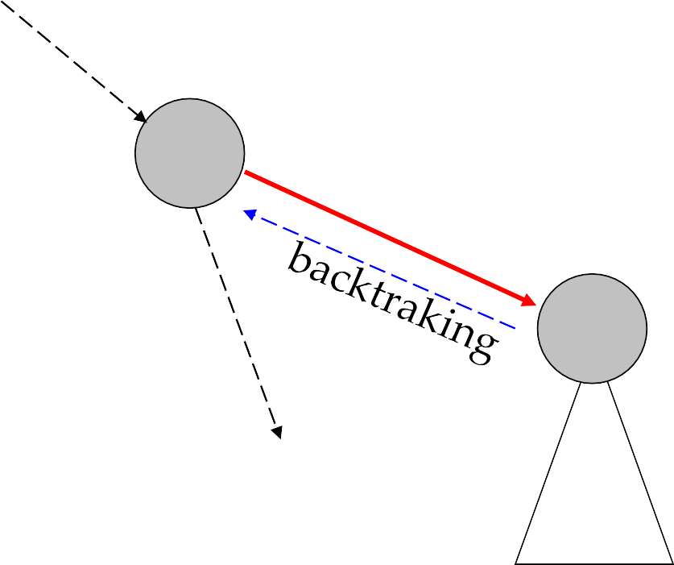
Critical Path – Case 1
est(v) to be updated
v
eft(w) known
Upon backtracking from
w:
est(v) is updated if eft(w) is larger than est(v)
and the path including edge vw is recognized as the critical path for tast v
and the eft(v) is updated accordingly
w
just finished

Slide 20


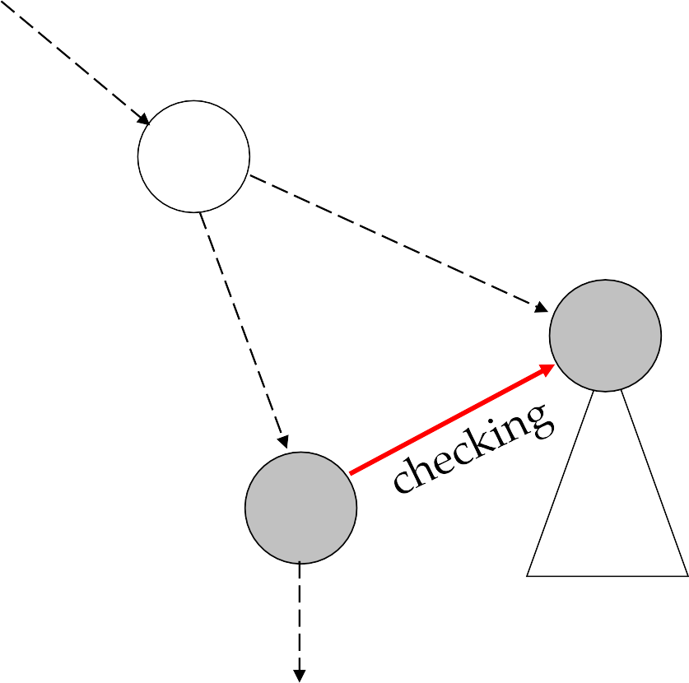
Critical Path – Case 2
Checking w:
est(v) is updated if eft(w) is larger than est(v)
and the path including edge vw is recognized as the critical path for task v
and the eft(v) is updated accordingly
c
eft(w) known
w
finished (Why?)
v
est(v) to be updated

Slide 21


Critical Path by DFS
void dfsCritSweep(IntList[ ] adjVertices,int n, int[ ] duration, int[ ] critDep, int[ ] eft)
<Allocate color array and initialize to white>
For each vertex v of G, in some order
if (color[v]==white)
dfsCrit(adjVertices, color, v, duration, critDep, eft);
// Continue loop
return;

Slide 22


Critical Path by DFS
void dfsCrit(.. adjVertices, .. color, .. v, int[ ] duration, int[ ] critDep, int[ ] eft)
int w; IntList remAdj; int est=0;
color[v]=gray; critDep[v]=-1; remAdj=adjVertices[v];
while (remAdj≠nil) w=first(remAdj);
if (color[w]==white)
dfsTopo(adjVertices, color, w, duration, critDep, efs);
if (eft[w]≥est) est=eft[w]; critDep[v]=w
else//checking for nontree edge
if (eft[w]≥est) est=eft[w]; critDep[v]=w
•
•
•
remAdj=rest(remAdj); eft[v]=est+duration[v]; color[v]=black; return;
When is the eft[w] initialized?
Only black vertex

Slide 23


Analysis of Critical Path Algorithm
Correctness:
When eft[w] is accessed in the while-loop, the w must not be gray(otherwise, there is a cycle), so, it must be black, with eft initialized.
According to DFS, each entry in the eft array is assigned a value exactly once. The value satisfies the definition of eft.
Complexity
Simply same as DFS, that is Θ(n+m).

Slide 24

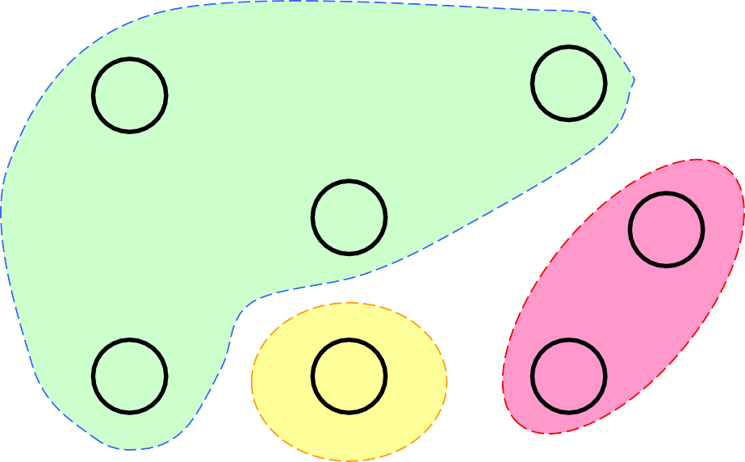



SCC: Strongly Connected Component
A
D
Condensation Graph G↓
B
G
ABDF
EG
F C E
Graph G
3 Strongly Connected Components
C
It’s acyclic, Why?
Note: two SCC in one DFS tree

Slide 25






Transpose Graph
Condensation Graph G↓
A
D
B
G
ABDF
EG
F C E
Tranpose Graph G^{T} Connected Components unchanged according to vertices
C
But, DFS tree changed

Slide 26






Basic Idea - G
Reverse topo order for leader finish time: C₁, (C4), C₂, C₃, C₄
C₁
C₄
C₂
a DFS tree with 4 connected components, depicted as a condensation
C₃
Original edge

Slide 27


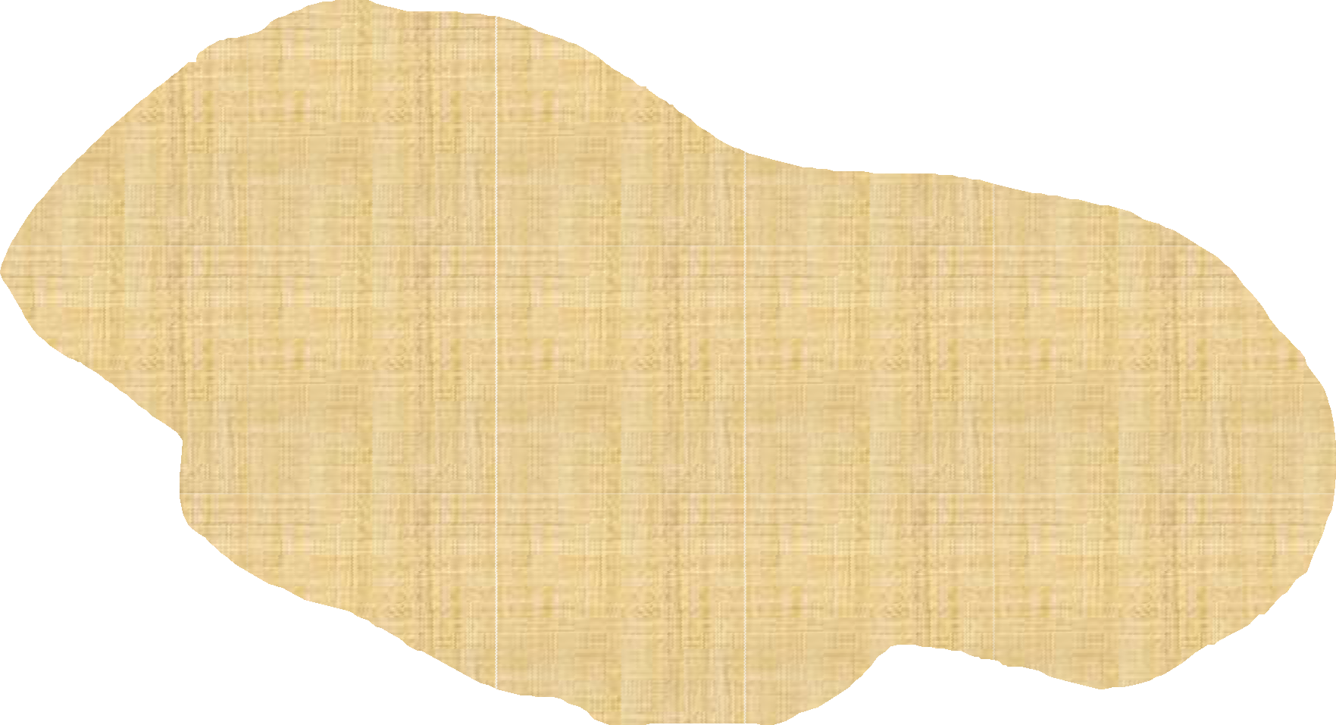




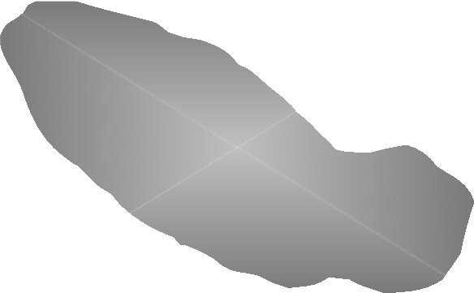
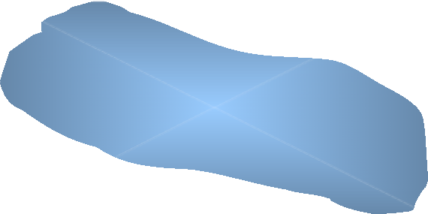
Basic Idea - G^{T}
Transposed edge
Original Graph
C₁
C₄
C₂
C₃
a DFS tree with 4 connected components, depicted as a condensation

Slide 28








SCC - An Example
A
D
A
D
B
B
G
G
F
C
E
F
C
E
A
D
A
D
transposed
B
G
B
G
F C
C D B F A G E
E
F
C
E
push/pop

Slide 29


Strong Component Algorithm: Outline
void strongComponents(IntList[] adjVertices, int n, int[]
scc)
//Phase 1
1. IntStack finishStack=create(n);
2. Perform a depth-first search on G, using the DFS skeleton. At postorder processing for vertex v, insert the statement: push(finishStack, v)
//Phase 2
3. Compute G^{T}, the transpose graph, represented as array adjTrans of adjacency list.
4. dfsTsweep(adjTrans, n, finishStack, scc);
return
Note: G and G^{T} have the same SCC sets

Slide 30


Strong Component Algorithm: Core
void dfsTsweep(IntList[] adjTrans, int n, IntStack finishStack, int[] scc)
<Allocate color array and initialize to white>
while (finishStack is not empty)
int v=top(finishStack);
pop(finishStack);
if (color[v]==white)
dfsT(adjTrans, color, v, v, scc);
return;
void dfsT(IntList[] adjTrans, int[] color, int v, int leader, int[] scc)
Use the standard depth-first search skeleton. At postorder processing for vertex v insert the statement:
scc[v]=leader;
Pass leader and scc into recursive calls.
•
•

Slide 31


Leader of a Strong Component
For a DFS, the first vertex discovered in a strong component S_{i} is called the leader of S_{i} .
Each DFS tree of a digraph G contains only complete strong components of G, one or more.
o Proof: Applying White Path Theorem whenever the leader of S_{i} (i=1,2,…p) is discovered, starting with all vertices being white.
The leader of S_{i} is the last vertex to finish among all vertices of S_{i}. (since all of them in the same DFS tree)

Slide 32
















Path between SCCs
The leader of S_{i}
At discovering
x can’t be gray.
v_{i}x-path is a White Path, or
otherwise, x is black (consider the [possible] last non-white vertex z on the v_{i}x-path)
v_{i}
S_{i}
^{S}j2
What’s the color?
Existing a yv_{i}-path, so x must be in a different strong component.
No v_{i}y-path can exist.
z
x
y
^{S}j1
See Lemma 7.8 & 7.9
p. 360 of [Baase01]
Gray

Slide 33

Active Intervals
If there is an edge from S_{i} to S_{j}, then it is impossible that the active interval of v_{j} is entirely after that of v_{i}. (Note: for leader v_{i} only)
There is no path from a leader of a strong component to any gray vertex.
If there is a path from the leader v of a strong component to any x in a different strong component, v finishes later than x.

Slide 34


Correctness of Strong Component Algorithm(1)
In phase 2, each time a white vertex is popped from finishStack, that vertex is the Phase 1 leader of a strong component.
The later finished, the earlier popped
The leader is the first to get popped in the strong component it belongs to
If x popped is not a leader, then some other vertex in the strong component has been visited previously. But not a partial strong component can be in a DFS tree, so, x must be in a completed DFS tree, and is not white.

Slide 35


Correctness of Strong Component Algorithm(2)
In phase 2, each depth-first search tree contains exactly one strong component of vertices
Only “exactly one” need to be proved
Assume that v_{i}, a phase 1 leader is popped. If another component S_{j} is reachable from v_{i} in G^{T}, there is a path in G from v_{j} to v_{i}. So, in phase 1, v_{j} finished later than v_{i}, and popped earlier than v_{i} in phase 2. So, when v_{i} popped, all vertices in S_{j} are black. So, S_{j} are not contained in DFS tree containing v_{i}(S_{i}).

Slide 36




Thank you!
Q & A
Yu Huang
http://cs.nju.edu.cn/yuhuang

